Slide 1

SCADA for Sailing Boat Autopilot
Natalia Drzazga, Jan Gorgoń

Slide 2
SCADA for Sailing Boat Autopilot
Maintaining the course of sailing using rudder
Software should maintain selected course without overshooting
Alarm defined for the situation of critically low level of battery voltage
Triggering the state of engine needs to authenticate
Visualisation and animation of current, past and set course
Autopilot needs to be turned on to maintain course

Slide 3
Environment
AVEVA InTouch HMI
Demo version of program
Wide range of graphical elements for HMI visualization
Scripts for backend
Alarm managing

Slide 4
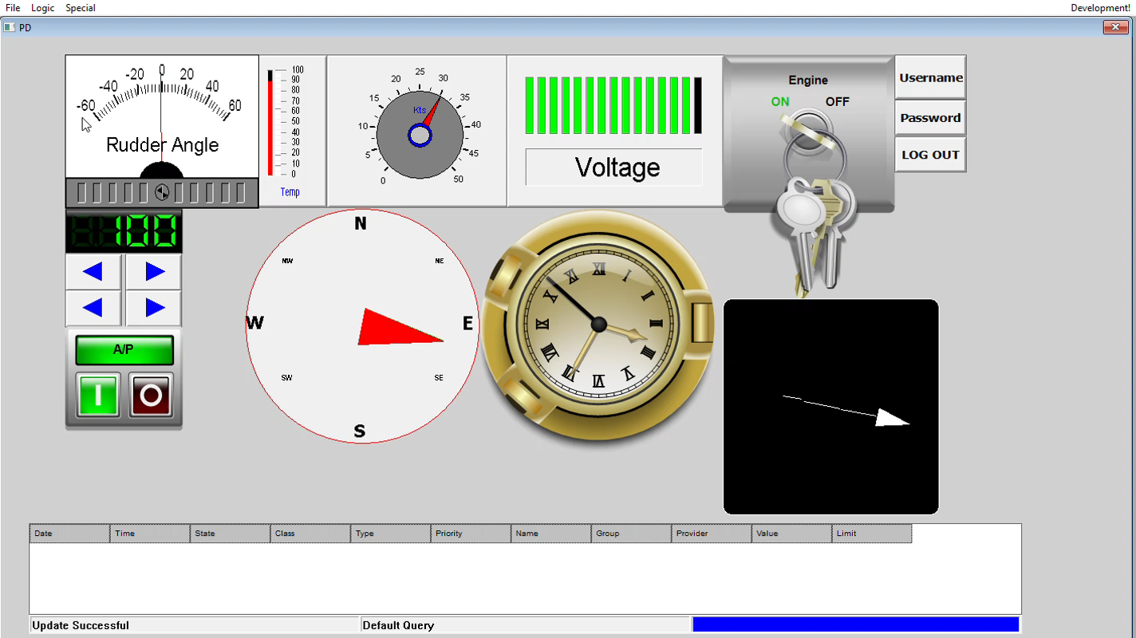

Slide 5
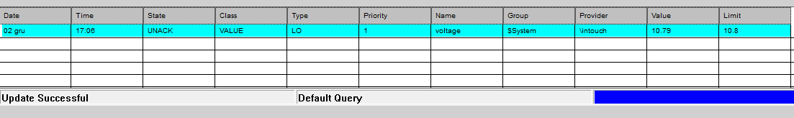
Alarm for battery voltage
Alarm occures when voltage is:
Lower than 10.8 V
Higher than 14.4 V
Deleted by turning on the engine

Slide 6
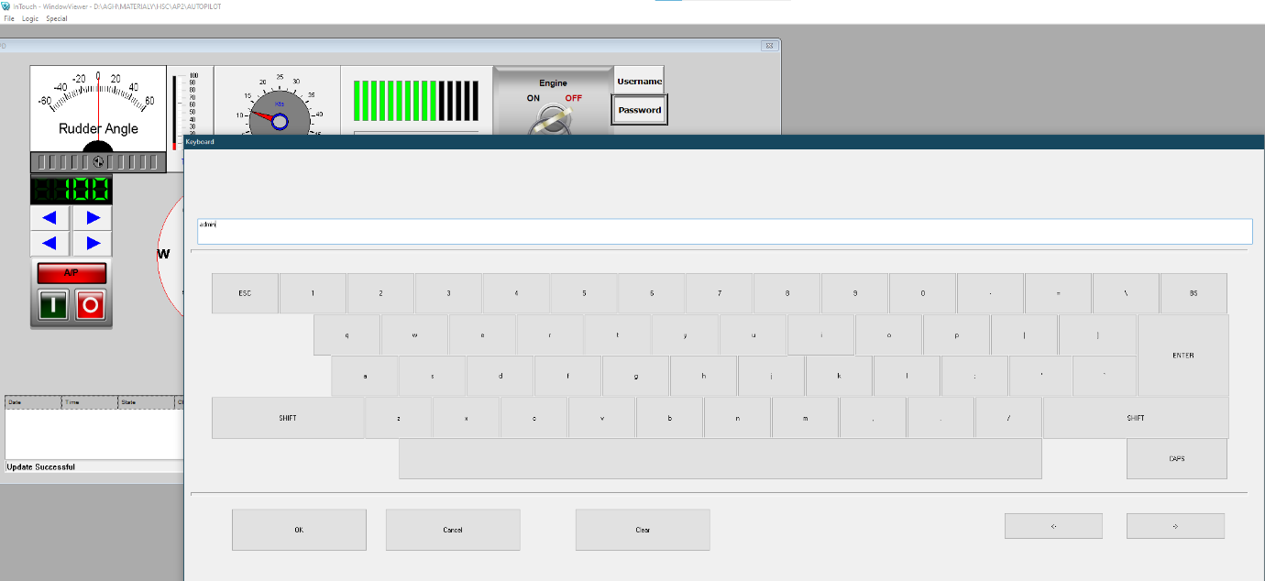
Login Panel
User need to log in entering username and password

Slide 7
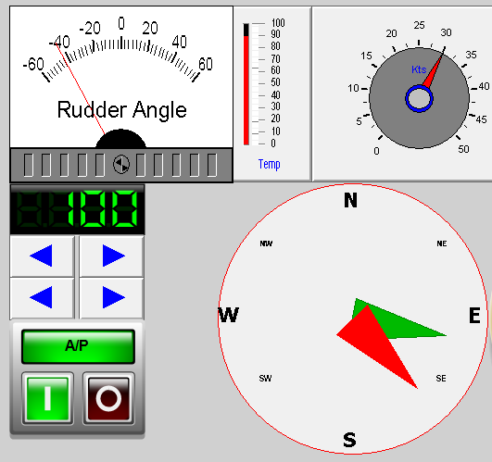
Autopilot panel
Buttons changing the set course
Switch turning on the Autopilot
Rudder angle gauge shows the current inclination of rudder
Thermometer and speedometer
Compass

Slide 8

Historic course panel
Shows the history of boat turning
in last few seconds

Slide 9
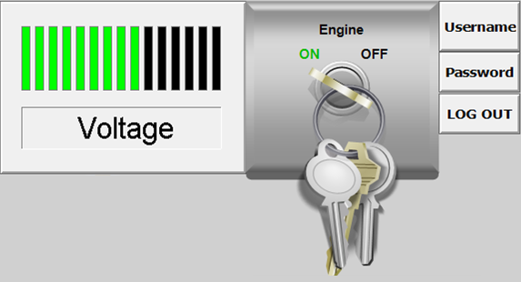
Ignition starter and battery voltage

Slide 10
Thank You

